Slide 1


Pivotal CF
Overview for PCF Immerison

Slide 2
Pivotal CF
Dave Roberts
Advisory Field Engineer
I have been building enterprise systems for 15 years. I love agile
methodologies; simple, testable solutions and scalable architectures.


Slide 3
Agenda

What we will see today
1
2
3
Evolution
Demo
Industry Trends
Of Cloud Architectures
Pivotal CF Live
Driving Enterprises Today
4
5
6
Cloud Foundry
Pivotal CF
Case Studies
The OSS Community
Enterprise Cloud Foundry
Who’s Using It?

Slide 4

Evolution of Cloud Architectures

Slide 5
The Power of PaaS

The “It Just Works” Experience
Traditional IT
IaaS
PaaS
Applications
Applications
You
Manage
Applications
Data
Data
Data
Agility and Cost Savings
You Manage
Runtime
Runtime
Runtime
Middleware
Middleware
Middleware
You Manage
O/S
O/S
O/S
Virtualization
Virtualization
Virtualization
Pivotal CF on IaaS
Servers
Servers
IaaS Provider
Servers
Storage
Storage
Storage
Networking
Networking
Networking
Cloud Enablement

Slide 6



Deploying an Application

IaaS v. PaaS
Provision VM
Install Application Runtime
Deploy Application
Configure Load Balancer
cf push
Configure SSL Termination
Configure Service Connectivity
Configure Firewall

Slide 7
Scaling an Application

IaaS v. PaaS
Provision New VM
Install Application Runtime
Deploy Application
cf scale
Configure Load Balancer / Update Route
Configure Service Connectivity
Configure Firewall

Slide 8


Industry Analysts

What do they think?
“IaaS without PaaS capabilities becoming a dying breed.
In 2014…IaaS providers with no PaaS services…and no ecosystem of developers will go the way of the dodo bird.”
“The single most powerful thing you can do this year is to enable your developers with a fast and flexible PaaS.
Cloud Foundry fits the bill nicely, and the ease of deployment is the same whether you're deploying a Node.js prototype or a Java project with scads of external services.”

Slide 9
DEMO


Slide 10
DEMO


Slide 11
DEMO


Slide 12
DEMO


Slide 13

Industry Trends
Notes:
Use this slide as an alternative for all your section breaks if you don’t want to work with MagicMove animations

Slide 14

 Wall Street Journal - Software is Eating the World

Marc Andreesen
Coauthor of Mosaic, cofounder of Netscape and technology visionary.
In short, software is eating the world.
Photo by JD Hancock

Slide 15






Software is Changing Industries

Starting at 0 in 2011, these companies have created more then 50B in market valuation.
$3.5B valuation
Financial Services
$40B valuation
Transportation
$26B valuation
Entertainment
$3.5B valuation
Travel & Hospitality
$3.2B Acquisition by Google
Home Automation
$26B valuation
Automotive

Slide 16

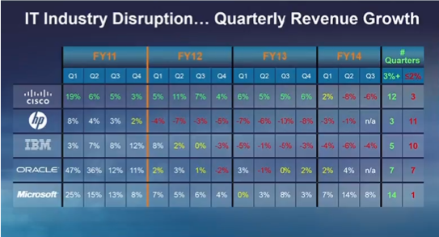
Top 5 IT Companies

Since 2011, these companies have had 32 quarters of revenue growth < 2%

Slide 17



What We’re Hearing From Customers


Need for Speed
Cloud
Enterprises are being driven to compete, innovate & execute faster than ever before:
Global reach and emerging markets
Ever-increasing customer expectations
Legacy environment & cost pressures
Mobile
Social
Big Data
At a time when we’re witnessing the most disruptive platform shifts and advances in technology in over 30 years

Slide 18
Business Expectations Exceed IT Capabilities

The Unsustainable Path for Traditional IT
IT Technology Eras
Mainframe
Client-Server
Cloud
The exponential increase in business expectations is unsustainable for IT
Millions of Apps
Billions of Users
Business Expectations
Ability of IT to Deliver S/W
Steady IT Budgets*
$ $ $ $ $ $
* Source: Gartner, 2013: “Hunting and Harvesting in a Digital World: The 2013 CIO Agenda”
Notes:
`

Slide 19





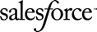





Great Software Remains Constrained By Silos

Modern Silos Hold Apps & Data Captive
Modern Silos
Legacy Silos
Captive apps and data
Closed source/proprietary
Vendor lock-in
Talent and Expertise gap

Slide 20
Mobile Trends in the Enterprise

Where we are heading
20%
90%
2013
2017
20% of enterprise
apps are mobile
90% of enterprise apps will be desktop and mobile
Source: Gartner predicts

Slide 21

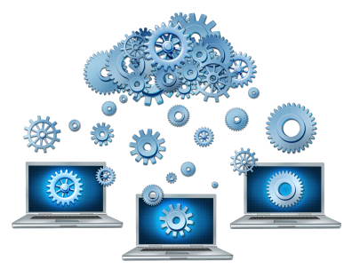
Rapid Innovation Requires a New Approach

Developers
Operators
Dramatically improve the developer experience
Agile teams, rapid iteration
Ingest and incubate open source advancements and new data services
Continuous delivery, no planned downtime
Instant scaling of apps and data services
Automation and deployment consistency at every step

Slide 22

Cloud Foundry
The OSS Community

Slide 23
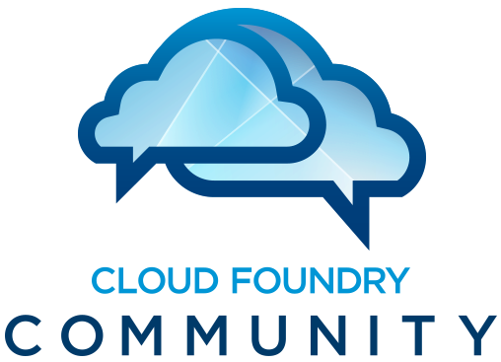
Cloud Foundry

Open everything

Slide 24




















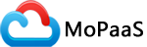







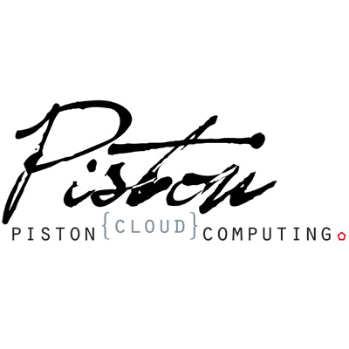



The Cloud Foundry Foundation


The Largest Open Source PaaS Ecosystem
Coming Soon
Platinum members
Gold members
Anchora
Silver members
Over 100k downloads of Cloud Foundry (OSS) software and tools!

Slide 25















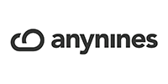

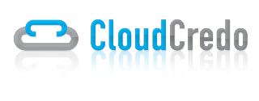

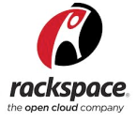






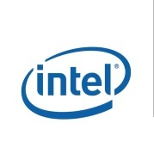




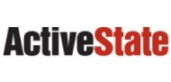
The Largest Open Source PaaS Ecosystem

Driven by the Community

Slide 26

Pivotal CF
The Leading Enterprise Cloud Foundry Distribution

Slide 27


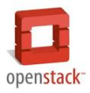


Core Tenets of Pivotal CF

The Enterprise Platform as a Service
Radically Simple, Developer Friendly
Broad Ecosystem Services
Operational Benefits for Every Application
Push an app and “it just works”
Build applications that consume increasing amounts of data, supporting wide ranging use cases
Support new application patterns like Microservices
Highly scalable, self healing
Logging and audit trail requirements
Existing enterprise policies on user access & authorization
Application Monitoring and Operational metrics
Application Uptime SLAs
Data Services
App Services
Mobile Services
Easy to add and customize
Deploy, Operate, Update & Scale with minimal downtime on Any IaaS
….and more

Slide 28
Pivotal CF

Commercially Supported Enterprise PaaS by Pivotal
Certified upgrades, curated & tested quarterly releases
Operations Manager Cloud Administrative Console
Elastic Runtime Developer Console
Built-in Application Performance Monitoring (APM)
Operational Metrics service
Auto-Scaling service
Easy LDAP/Active Directory Integration
Historical Usage Data per Application Instance
Declarative Availability Zones
Behind the firewall download packages (do not require internet access)
Enterprise documentation (PDF format)

Slide 29
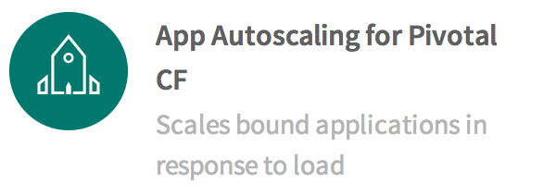
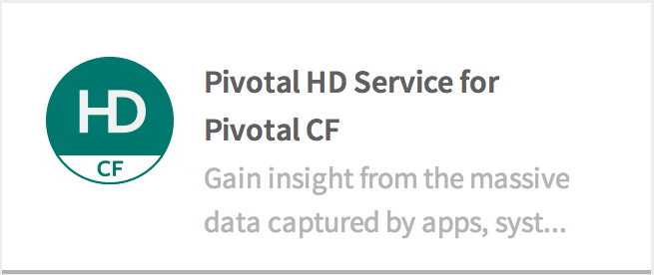
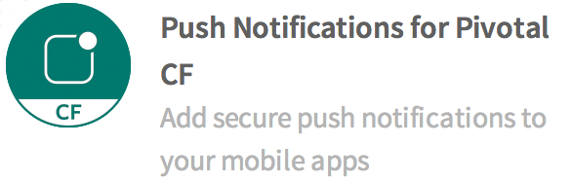

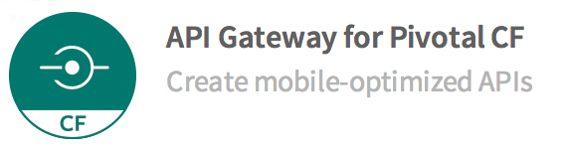
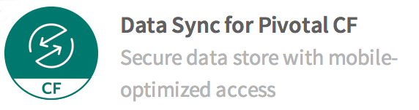
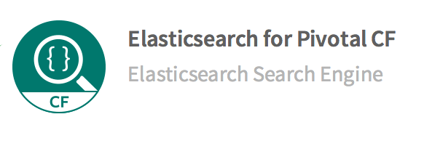
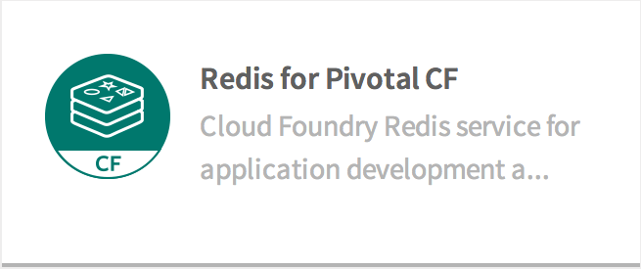
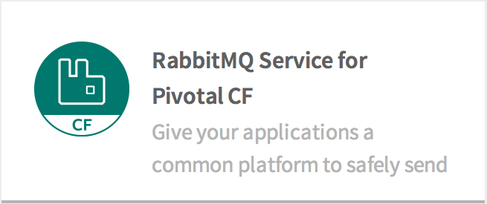
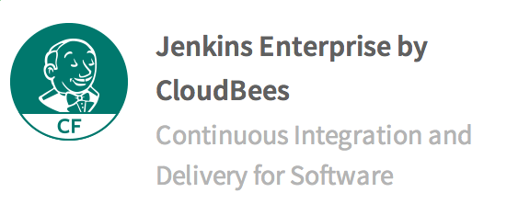
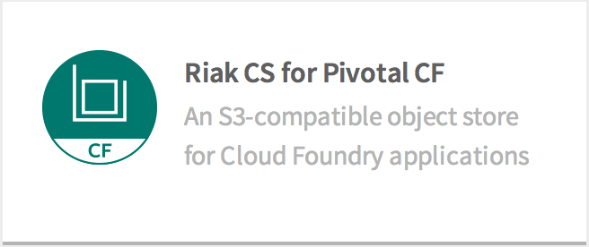
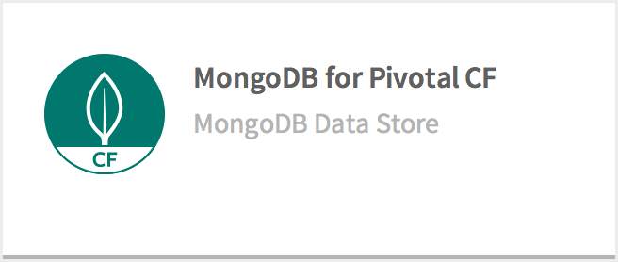
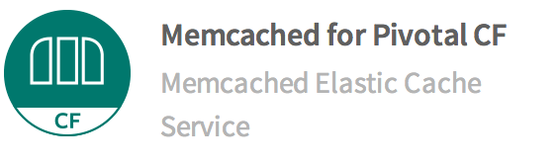
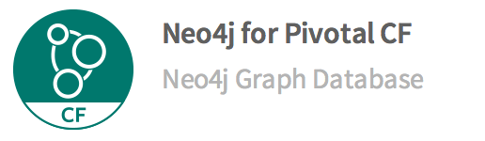
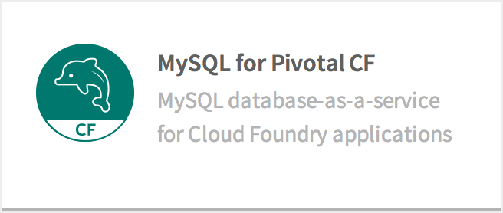
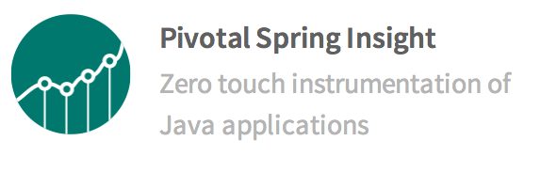
Pivotal CF Services

Your Service Menu
Not Pictured: Ops Metrics for JMX monitoring

Slide 30



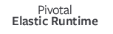

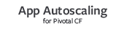
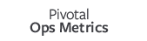
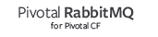

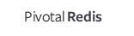

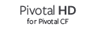
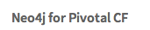

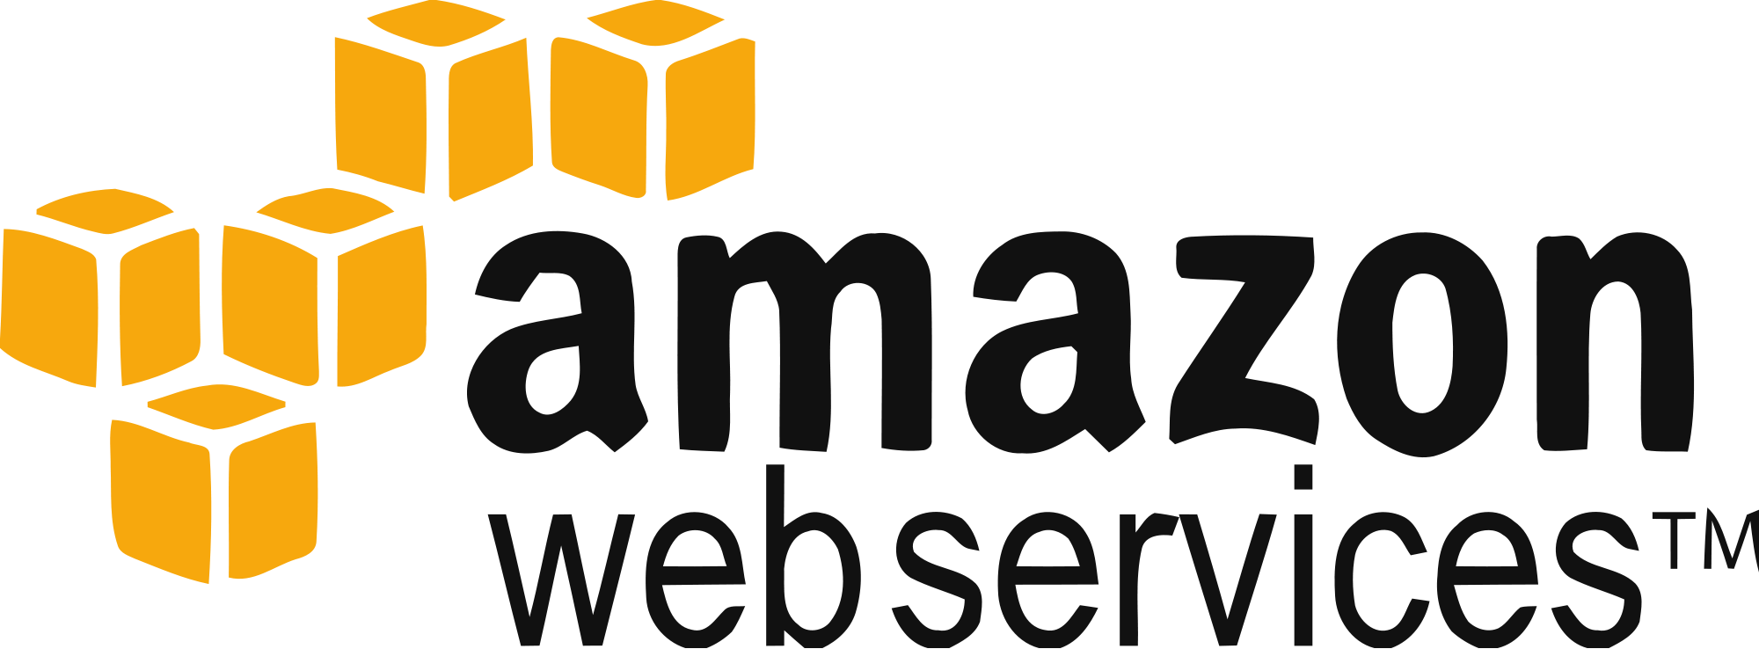
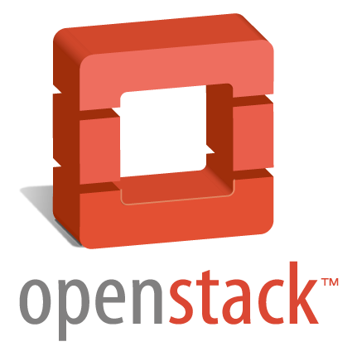
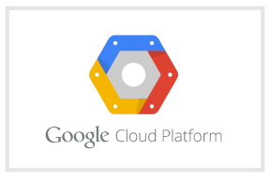

Pivotal Ops Manager


Managing Your Platform
Pivotal Ops Manager
Click to install
No downtime updates
Explore install logs
Click to scale the platform
CloudBees Jenkins
Enterprise
Built-in High Availability
Cassandra
for Pivotal CF
ElasticSearch
for Pivotal CF
Mobile Services
for Pivotal CF
Built-in Platform Monitoring
BOSH Director
BOSH Agent
Integrated services
IaaS

Slide 31

Case Studies

Slide 32
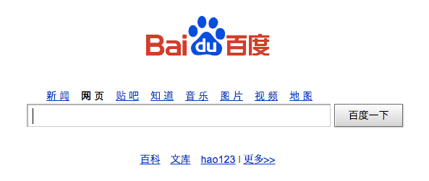
1 Billion Page Views A Day Powered by Cloud Foundry!
Baidu

Chinese Google

Slide 33
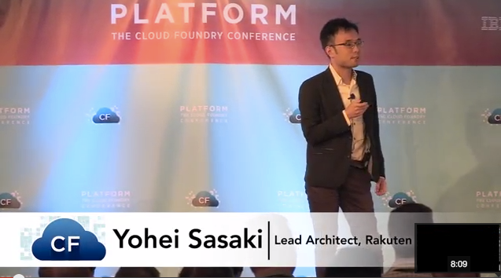

Rakuten

Largest e-commerce site in Japan
90%
Reduction in Operation Costs
$
Big Cost Savings
Dramatic increase in Server to Admin ratio

Slide 34

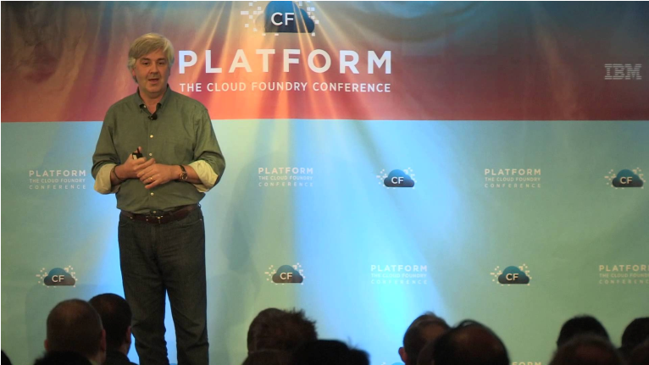



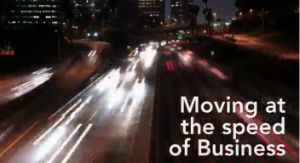
Warner Music Group

From Zero to Factory
Fail, Learn, Adapt, Repeat.
6 Months to 6 Weeks
$1.1M Saving per App

Slide 35
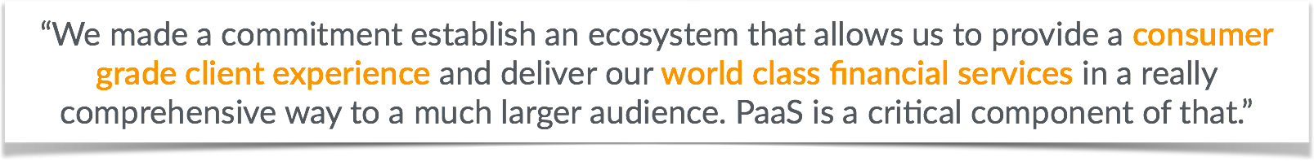

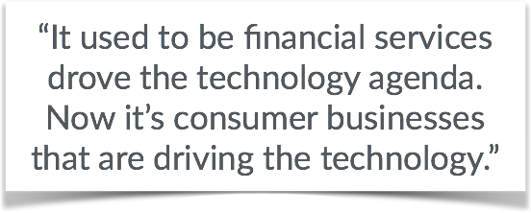
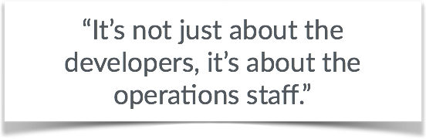
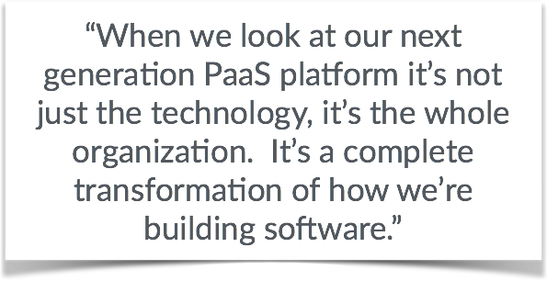
Bank of New York Mellon

https://www.youtube.com/watch?v=eJ1j6qezthY

Slide 36


Pivotal CF
A NEW PLATFORM FOR A NEW ERA

